Slide 1


Big Data Infrastructure
CS 489/698 Big Data Infrastructure (Winter 2016)
Week 2: MapReduce Algorithm Design (2/2)
January 14, 2016
Jimmy Lin
David R. Cheriton School of Computer Science
University of Waterloo
These slides are available at http://lintool.github.io/bigdata-2016w/
This work is licensed under a Creative Commons Attribution-Noncommercial-Share Alike 3.0 United States See http://creativecommons.org/licenses/by-nc-sa/3.0/us/ for details

Slide 2

Source: Wikipedia (The Scream)

Slide 3

Source: Wikipedia (Japanese rock garden)

Slide 4
MapReduce Algorithm Design
How do you express everything in terms of m, r, c, p?
Toward “design patterns”

Slide 5

MapReduce
Source: Google

Slide 6
MapReduce: Recap
Programmers must specify:
map (k, v) → <k’, v’>*
reduce (k’, v’) → <k’, v’>*
All values with the same key are reduced together
Optionally, also:
partition (k’, number of partitions) → partition for k’
Often a simple hash of the key, e.g., hash(k’) mod n
Divides up key space for parallel reduce operations
combine (k’, v’) → <k’, v’>*
Mini-reducers that run in memory after the map phase
Used as an optimization to reduce network traffic
The execution framework handles everything else…

Slide 7
k₁
v₁
k₂
v₂
k₃
v₃
k₄
v₄
k₅
v₅
k₆
v₆
map
map
map
map
a
1
b
2
c
3
c
6
a
5
c
2
b
7
c
8
combine
combine
combine
combine
a
1
b
2
c
9
a
5
c
2
b
7
c
8
partition
partition
partition
partition
Shuffle and Sort: aggregate values by keys
a
1
5
b
2
7
c
2
9
8
reduce
reduce
reduce
r₁
s₁
r₂
s₂
r₃
s₃

Slide 8
“Everything Else”
The execution framework handles everything else…
Scheduling: assigns workers to map and reduce tasks
“Data distribution”: moves processes to data
Synchronization: gathers, sorts, and shuffles intermediate data
Errors and faults: detects worker failures and restarts
Limited control over data and execution flow
All algorithms must expressed in m, r, c, p
You don’t know:
Where mappers and reducers run
When a mapper or reducer begins or finishes
Which input a particular mapper is processing
Which intermediate key a particular reducer is processing

Slide 9
Tools for Synchronization
Cleverly-constructed data structures
Bring partial results together
Sort order of intermediate keys
Control order in which reducers process keys
Partitioner
Control which reducer processes which keys
Preserving state in mappers and reducers
Capture dependencies across multiple keys and values

Slide 10
MapReduce API*
Mapper<K_{in},V_{in},K_{out},V_{out}>
void setup(Mapper.Context context) Called once at the beginning of the task
void map(K_{in} key, V_{in} value, Mapper.Context context) Called once for each key/value pair in the input split
void cleanup(Mapper.Context context) Called once at the end of the task
Reducer<K_{in},V_{in},K_{out},V_{out}>/Combiner<K_{in},V_{in},K_{out},V_{out}>
void setup(Reducer.Context context) Called once at the start of the task
void reduce(K_{in} key, Iterable<V_{in}> values, Reducer.Context context) Called once for each key
void cleanup(Reducer.Context context) Called once at the end of the task
*Note that there are two versions of the API!

Slide 11
Preserving State
Mapper object
Reducer object
one object per task
state
state
setup
API initialization hook
setup
map
one call per input key-value pair
reduce
one call per intermediate key
cleanup
API cleanup hook
close

Slide 12
Scalable Hadoop Algorithms: Themes
Avoid object creation
(Relatively) costly operation
Garbage collection
Avoid buffering
Limited heap size
Works for small datasets, but won’t scale!

Slide 13
Importance of Local Aggregation
Ideal scaling characteristics:
Twice the data, twice the running time
Twice the resources, half the running time
Why can’t we achieve this?
Synchronization requires communication
Communication kills performance
Thus… avoid communication!
Reduce intermediate data via local aggregation
Combiners can help

Slide 14
Shuffle and Sort
Mapper
intermediate files (on disk)
merged spills (on disk)
Combiner
Reducer
circular buffer (in memory)
Combiner
other reducers
spills (on disk)
other mappers

Slide 15
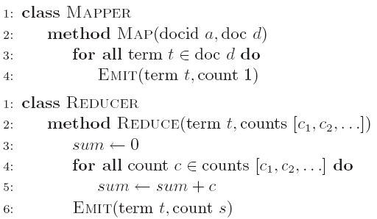
Word Count: Baseline
What’s the impact of combiners?

Slide 16
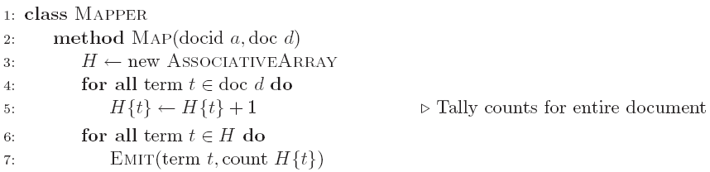
Word Count: Version 1
Are combiners still needed?

Slide 17
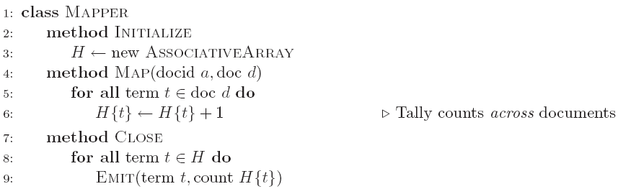
Word Count: Version 2
Key idea: preserve state across input key-value pairs!
Are combiners still needed?

Slide 18
Design Pattern for Local Aggregation
“In-mapper combining”
Fold the functionality of the combiner into the mapper by preserving state across multiple map calls
Advantages
Speed
Why is this faster than actual combiners?
Disadvantages
Explicit memory management required
Potential for order-dependent bugs

Slide 19
Combiner Design
Combiners and reducers share same method signature
Sometimes, reducers can serve as combiners
Often, not…
Remember: combiner are optional optimizations
Should not affect algorithm correctness
May be run 0, 1, or multiple times
Example: find average of integers associated with the same key

Slide 20
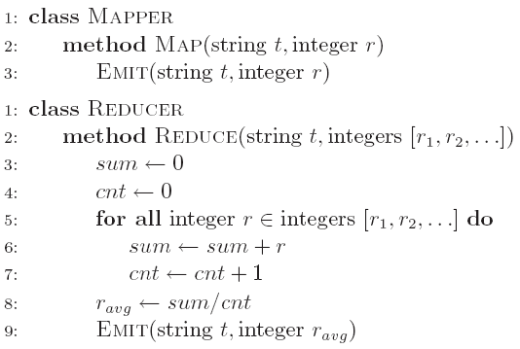
Computing the Mean: Version 1
Why can’t we use reducer as combiner?

Slide 21
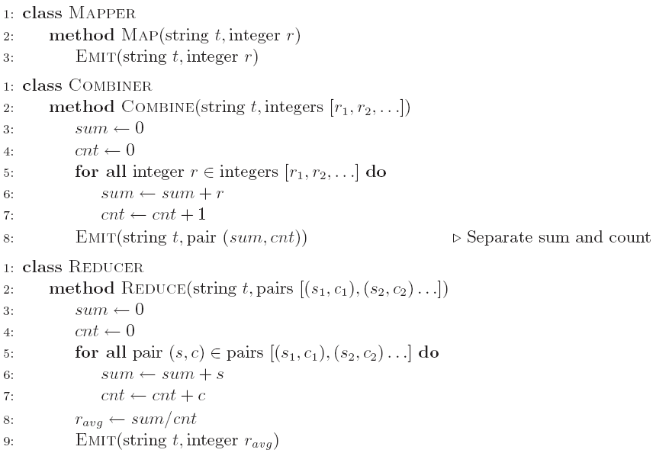
Computing the Mean: Version 2
Why doesn’t this work?

Slide 22
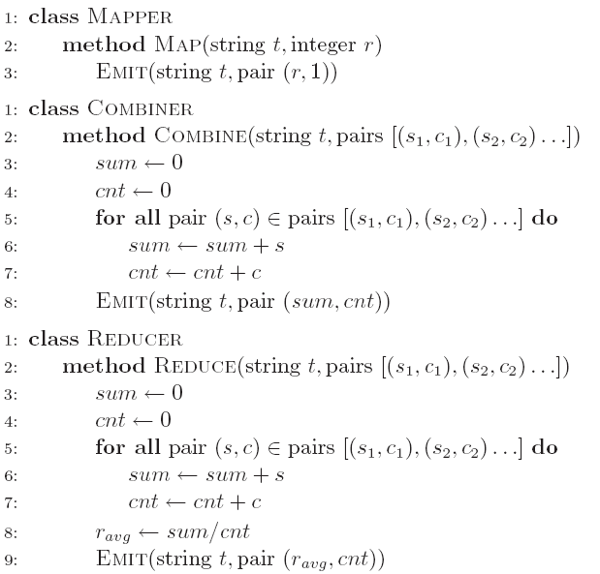
Computing the Mean: Version 3
Fixed?

Slide 23
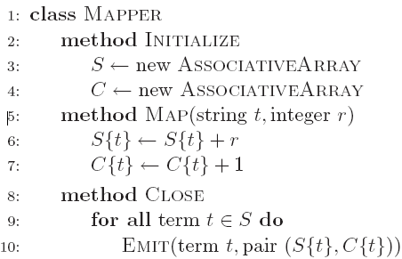
Computing the Mean: Version 4
Are combiners still needed?

Slide 24
MapReduce API
Mapper<K_{in},V_{in},K_{out},V_{out}>
Combiner<K_{in},V_{in},K_{out},V_{out}>
Reducer<K_{in},V_{in},K_{out},V_{out}>

Slide 25
Algorithm Design: Running Example
Term co-occurrence matrix for a text collection
M = N x N matrix (N = vocabulary size)
M_{ij}: number of times i and j co-occur in some context (for concreteness, let’s say context = sentence)
Why?
Distributional profiles as a way of measuring semantic distance
Semantic distance useful for many language processing tasks

Slide 26
MapReduce: Large Counting Problems
Term co-occurrence matrix for a text collection = specific instance of a large counting problem
A large event space (number of terms)
A large number of observations (the collection itself)
Goal: keep track of interesting statistics about the events
Basic approach
Mappers generate partial counts
Reducers aggregate partial counts
How do we aggregate partial counts efficiently?

Slide 27
First Try: “Pairs”
Each mapper takes a sentence:
Generate all co-occurring term pairs
For all pairs, emit (a, b) → count
Reducers sum up counts associated with these pairs
Use combiners!

Slide 28
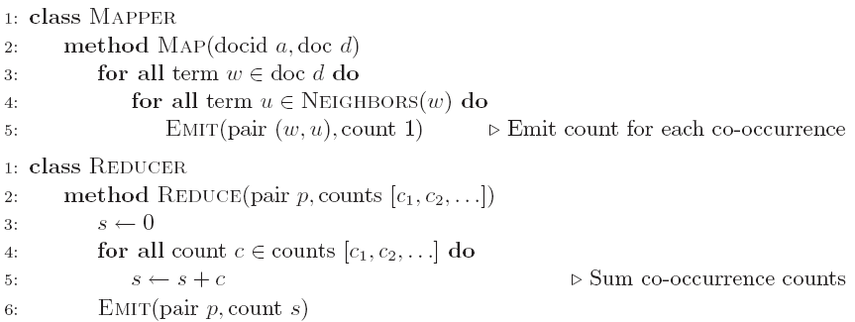
Pairs: Pseudo-Code

Slide 29
“Pairs” Analysis
Advantages
Easy to implement, easy to understand
Disadvantages
Lots of pairs to sort and shuffle around (upper bound?)
Not many opportunities for combiners to work

Slide 30
Another Try: “Stripes”
Idea: group together pairs into an associative array
Each mapper takes a sentence:
Generate all co-occurring term pairs
For each term, emit a → { b: count_{b}, c: count_{c}, d: count_{d} … }
Reducers perform element-wise sum of associative arrays
(a, b) → 1
(a, c) → 2
(a, d) → 5
(a, e) → 3
(a, f) → 2
a → { b: 1, c: 2, d: 5, e: 3, f: 2 }
a → { b: 1, d: 5, e: 3 }
a → { b: 1, c: 2, d: 2, f: 2 }
a → { b: 2, c: 2, d: 7, e: 3, f: 2 }
+
Key idea: cleverly-constructed data structure
brings together partial results

Slide 31
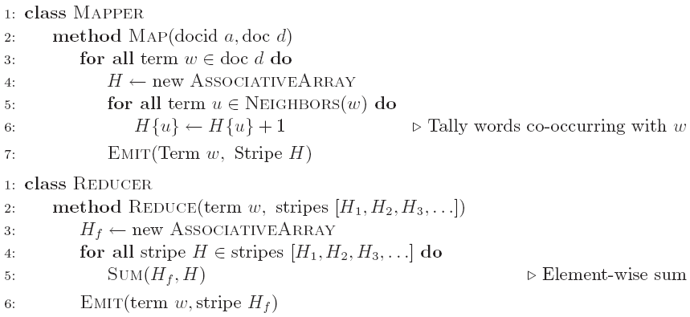
Stripes: Pseudo-Code

Slide 32
“Stripes” Analysis
Advantages
Far less sorting and shuffling of key-value pairs
Can make better use of combiners
Disadvantages
More difficult to implement
Underlying object more heavyweight
Fundamental limitation in terms of size of event space

Slide 33
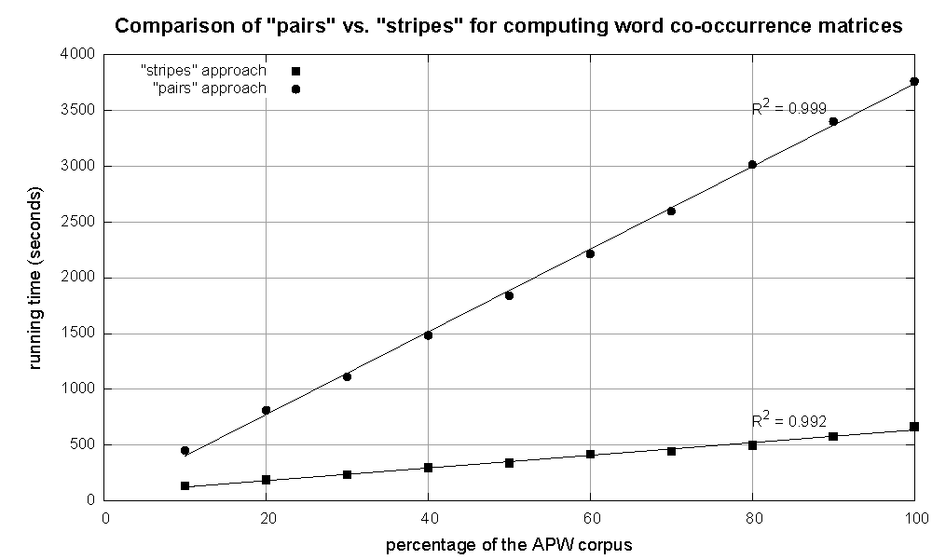
Cluster size: 38 cores
Data Source: Associated Press Worldstream (APW) of the English Gigaword Corpus (v3), which contains 2.27 million documents (1.8 GB compressed, 5.7 GB uncompressed)

Slide 34
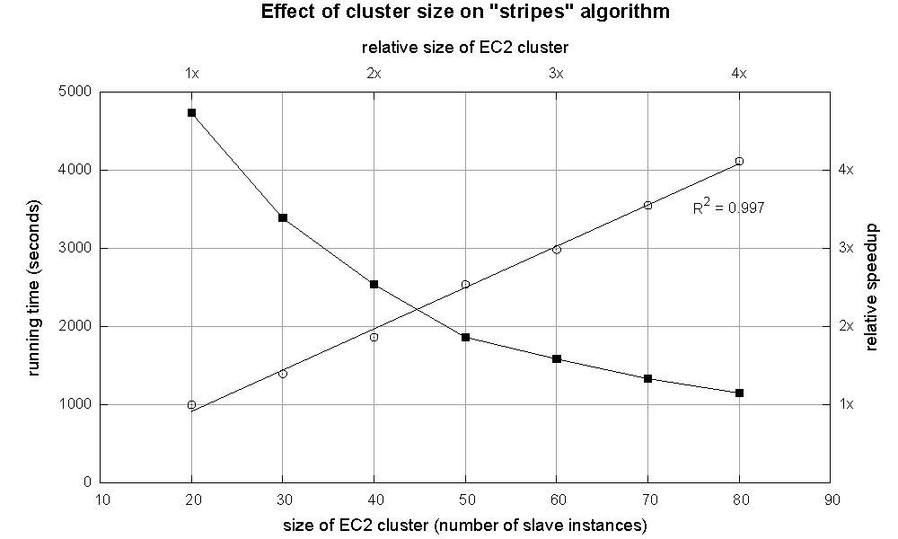

Slide 35
Stripes >> Pairs?
Tradeoff: Developer code vs. framework
Tradeoff: CPU vs. RAM vs. disk vs. network
Number of key-value pairs
Sorting and shuffling data across the network
Size of each key-value pair
De/serialization overhead
Local aggregation
Opportunities to perform local aggregation varies
Combiners make a big difference
Combiners vs. in-mapper combining
Watch out for load imbalance

Slide 36
Tradeoffs
Pairs:
Generates a lot more key-value pairs
Less combining opportunities
More sorting and shuffling
Simple aggregation at reduce
Stripes:
Generates fewer key-value pairs
More opportunities for combining
Less sorting and shuffling
More complex (slower) aggregation at reduce
Where’s the potential for load imbalance?

Slide 37
Relative Frequencies
How do we estimate relative frequencies from counts?
Why do we want to do this?
How do we do this with MapReduce?

Slide 38
f(B|A): “Stripes”
Easy!
One pass to compute (a, *)
Another pass to directly compute f(B|A)
a → {b₁:3, b₂ :12, b₃ :7, b₄ :1, … }

Slide 39
f(B|A): “Pairs”
What’s the issue?
Computing relative frequencies requires marginal counts
But the marginal cannot be computed until you see all counts
Buffering is a bad idea!
Solution:
What if we could get the marginal count to arrive at the reducer first?

Slide 40
f(B|A): “Pairs”
For this to work:
Must emit extra (a, *) for every b_{n} in mapper
Must make sure all a’s get sent to same reducer (use partitioner)
Must make sure (a, *) comes first (define sort order)
Must hold state in reducer across different key-value pairs
(a, *) → 32
Reducer holds this value in memory
(a, b₁) → 3
(a, b₂) → 12
(a, b₃) → 7
(a, b₄) → 1
…
(a, b₁) → 3 / 32
(a, b₂) → 12 / 32
(a, b₃) → 7 / 32
(a, b₄) → 1 / 32
…

Slide 41
“Order Inversion”
Common design pattern:
Take advantage of sorted key order at reducer to sequence computations
Get the marginal counts to arrive at the reducer before the joint counts
Optimization:
Apply in-memory combining pattern to accumulate marginal counts

Slide 42
Synchronization: Pairs vs. Stripes
Approach 1: turn synchronization into an ordering problem
Sort keys into correct order of computation
Partition key space so that each reducer gets the appropriate set of partial results
Hold state in reducer across multiple key-value pairs to perform computation
Illustrated by the “pairs” approach
Approach 2: construct data structures that bring partial results together
Each reducer receives all the data it needs to complete the computation
Illustrated by the “stripes” approach

Slide 43
Secondary Sorting
MapReduce sorts input to reducers by key
Values may be arbitrarily ordered
What if want to sort value also?
E.g., k → (v₁, r), (v₃, r), (v₄, r), (v₈, r)…

Slide 44
Secondary Sorting: Solutions
Solution 1:
Buffer values in memory, then sort
Why is this a bad idea?
Solution 2:
“Value-to-key conversion” design pattern: form composite intermediate key, (k, v₁)
Let execution framework do the sorting
Preserve state across multiple key-value pairs to handle processing
Anything else we need to do?

Slide 45
Recap: Tools for Synchronization
Cleverly-constructed data structures
Bring data together
Sort order of intermediate keys
Control order in which reducers process keys
Partitioner
Control which reducer processes which keys
Preserving state in mappers and reducers
Capture dependencies across multiple keys and values

Slide 46
Issues and Tradeoffs
Tradeoff: Developer code vs. framework
Tradeoff: CPU vs. RAM vs. disk vs. network
Number of key-value pairs
Sorting and shuffling data across the network
Size of each key-value pair
De/serialization overhead
Local aggregation
Opportunities to perform local aggregation varies
Combiners make a big difference
Combiners vs. in-mapper combining
Watch out for load imbalance

Slide 47
Debugging at Scale
Works on small datasets, won’t scale… why?
Memory management issues (buffering and object creation)
Too much intermediate data
Mangled input records
Real-world data is messy!
There’s no such thing as “consistent data”
Watch out for corner cases
Isolate unexpected behavior, bring local

Slide 48
Questions?
Remember: Assignment 1 due next Tuesday at 8:30am
Source: Wikipedia (Japanese rock garden)

